Slide 1


Content Guide
Glo Provider

Slide 2
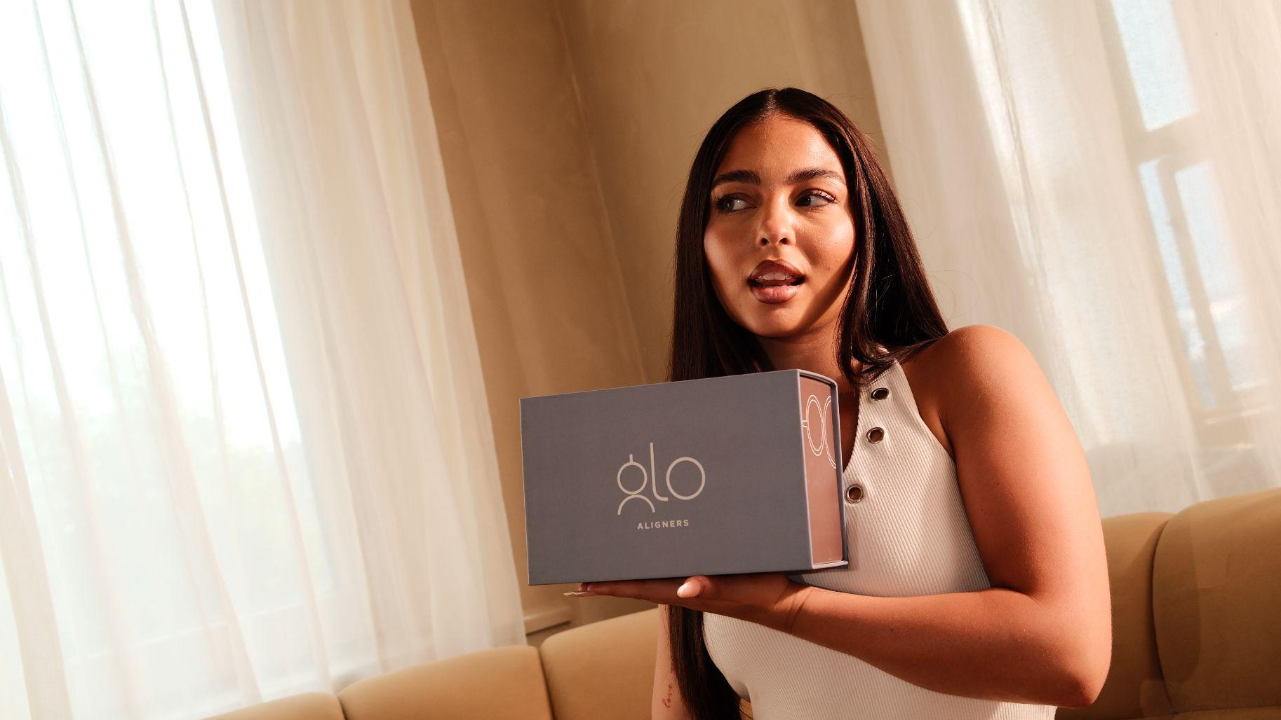
Creating Content with Glo
A quick guide to creating content that feels natural, educational and aligned with the Glo brand.

Slide 3
Think:
Clinical, but not boring
Educational, but easy to understand
Professional, but still personal
Real, not overly polished
Patient-focused
Confident and positive
The best content doesn’t need to feel like an advert. Show your patients, your team and your experience with Glo.
What Glo Content Should Feel Like:

Slide 4
What We Want to See
You as a Glo Provider
Show your experience using Glo in practice.
Ideas:
Why you chose Glo
Your first Glo case
What you like about Glo
A day as a Glo Provider
Why orthodontist-led treatment planning matters to you
Your Patients
Show the real patient journey.
Ideas:
Before & afters
Aligner fit appointments
Progress updates
Patient reactions
“Follow my patient’s Glo journey”
Common questions patients ask

Slide 5
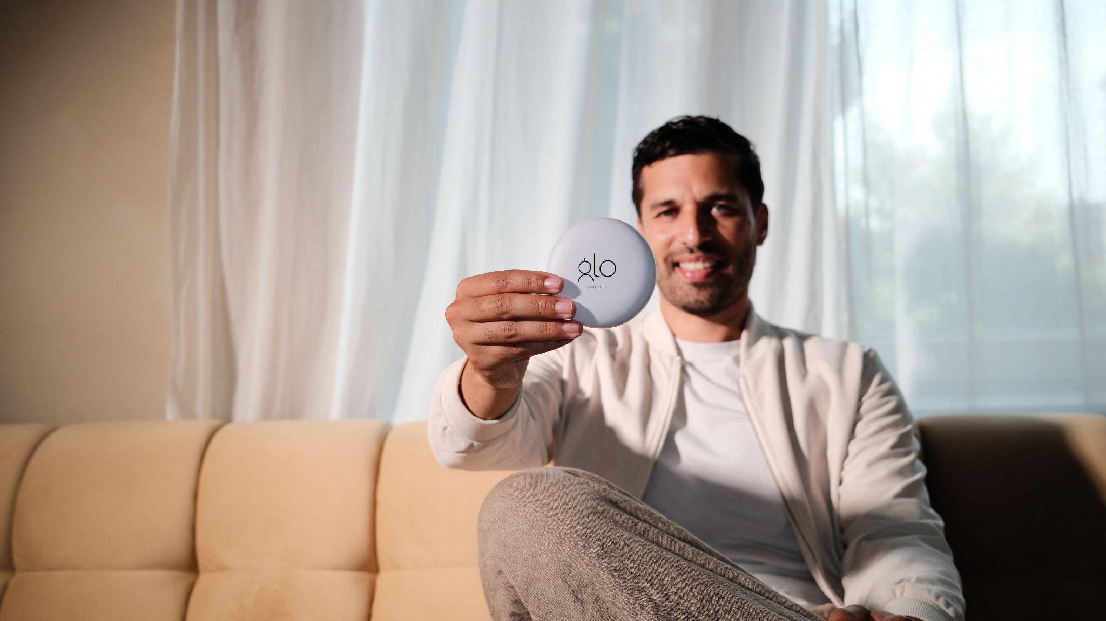
Examples

Slide 6
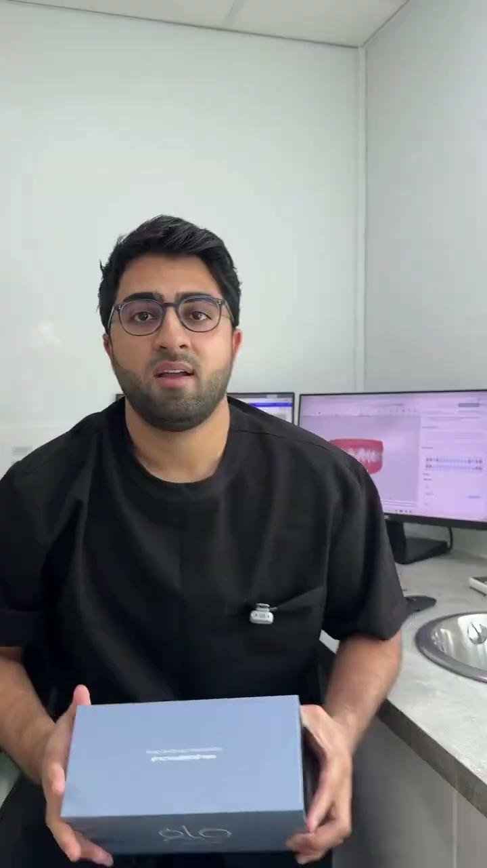
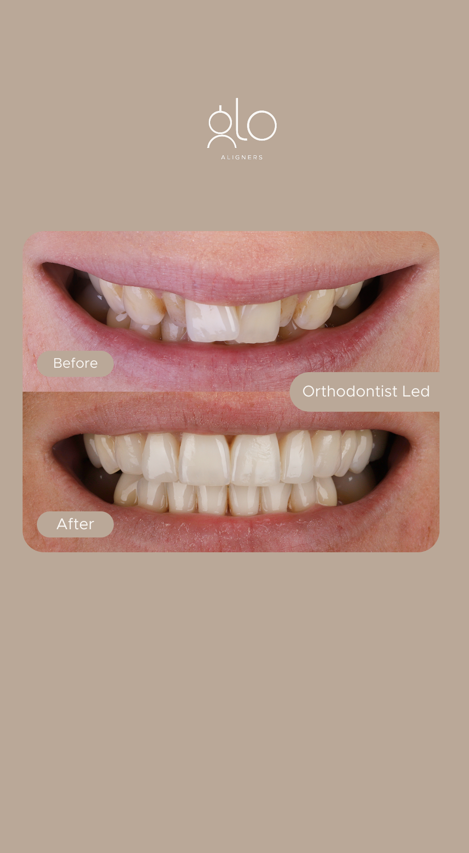
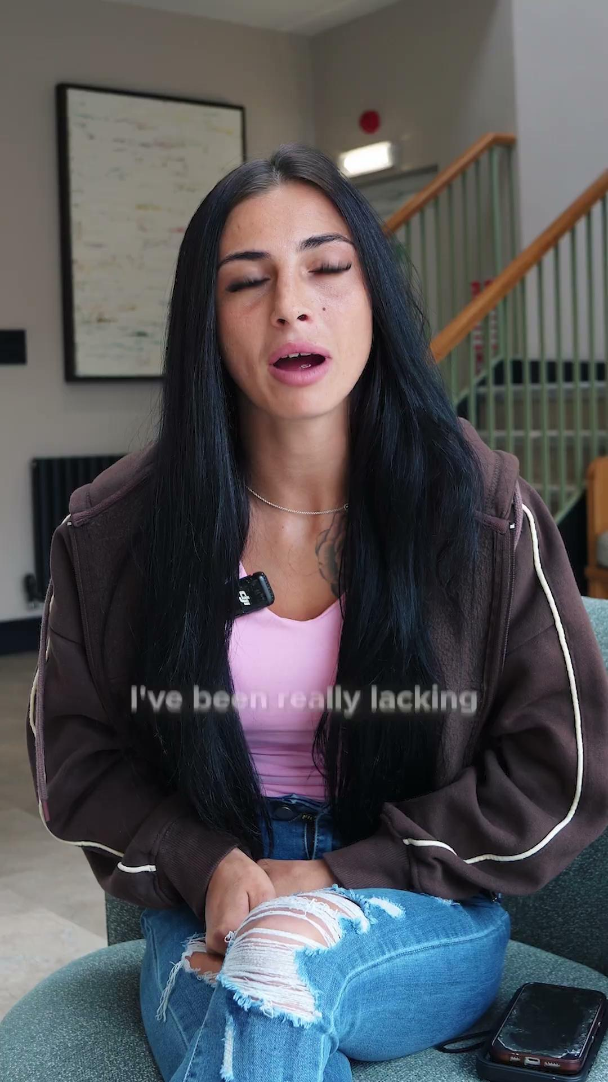

Slide 7
“Why I chose Glo”
30-second talking-head video explaining why you became a Provider.
“3 things I look for in an aligner system”
Educational, provider-led content.
“POV: Your first Glo Aligner fit”
Show clips from the appointment.
“Things I wish patients knew about clear aligners”
Quick educational points.
“Come with me to a Glo Aligner fit”
Short clips throughout the appointment.
“A day in the life of a Glo Provider”
Practice + patient + team content.
Easy Reels You Can Film:

Slide 8
This is where you can show the Glo experience in your practice.
For example:
Before:
“This is where we’re starting…”
During:
“Today we’re fitting [patient] with their first Glo Aligners.”
After:
“Here’s how we’re progressing…”
Glo Provider + Patient Content:

Slide 9
You could split it into:
Talking to camera
Personal, confident and informative.
Treatment content
Real appointments, scans, fits and progress.
Transformations
Before & afters and patient journeys.
Education
Simple answers to common questions.
Practice life
Team, behind-the-scenes and day-to-day content.
Content We Love:

Slide 10
Your phone is enough.
Film vertically
Face a window or use good lighting
Use a quiet space for talking videos
Keep the camera steady
Aim for 15 - 45 seconds
Don't worry about making it perfect
The most important thing is showing the real Glo experience in your practice.
No Production Team Needed:

Slide 11
Got something you've filmed? Send it our way.
We'd love to see:
Patient transformations
Glo fits
Provider talking-head videos
Educational content
Behind-the-scenes clips
Patient reactions
Anything Glo-related happening in your practice
Send your content to: marketing@gloaligners.co.uk
WhatsApp: +44 7557 188175
Send Us Your Content:

Slide 12
Premium Clear Aligners,
Expert orthodontist-planned.
Glo Aligners Marketing Strategy 2026/27

